Slide 1


INDIA’S FIRST
STATE-LED
INCUBATOR
FOR WOMEN
“PITCH PERFECT”

Slide 2
[COMPANY NAME:ROAD ASSISTANT]
ELEVATOR PITCH-BIETIANS
Hook: Have you ever seen a person who was helpless when met with an accident and lost his lives due to late medical aid in your relatives, friends, neighbors .If yes then here is my solution.
Product: We install an IOT device inside the vehicles tries maximum to avoid the accident with abs sensors ,it also has voice assistant in it. When they met with an accident that sensor would active and send details to nearby police ,patrol vehicles ,hospitals ,ambulances and relatives so that the person would be saved in less time.
Market: We are watching and experiencing a lot of such cases in our daily life and almost 1.50 millions per year so this would help the market a lot of people .We install in every automobile to reduce that
Revenue: We install this device in every automobile and charge for the installation only
Closing: In conclusion, we make a device which makes all these function possible. If you are interested in this product you can reach me out.
NAME: K HARSHAVARDHAN EMAIL:harshavardhan538421@gmail.com

Slide 3
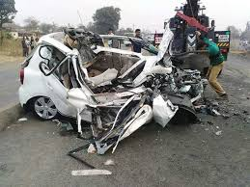
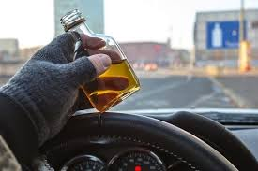
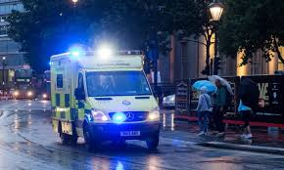
The Problem
Every year around 1.5lakh people die in the accidents even if 75% of them are not severe.
The 3 main reasons for these are the over speed, drunk and drive , late medical aid after the accident.
Not only these people the number of accidents are around 5lakhs and many more which are not registered
There is a person in my family who was died in accident even if it was small .The main reason of that death is it was happened early in the mornings 3am,so there was a late medical treatment and ambulance service and the other reason was it’s a highway .He was not died due to hit, he was died after the truck passed by his head.
As the number of automobiles are increasing day by day we have to come up with the new solutions to reduce accidents and maintain some technology to eradicate this and control all these.

Slide 4
DETAILS OF ROAD ACCIDENTS IN TELANGANA
YEAR | January - December
 | No.of Accidents | No.of fatalities | No.of Injuries
2014 | 20078 | 6906 | 21636
2015 | 21252 | 7110 | 22948
Grow Rate | 5.8 | 3.0 | 6.1
2016 | 22,811 | 7,219 | 24,217
2017 | 22,475 | 6,595 | 24,017
Grow Rate | -1.5 | -8.6 | -0.8
2018 | 22,230 | 6,603 | 23,613
2019 | 21,588 | 6,800 | 22,265
Growth Rate | -3% | 3% | -5.70%

Slide 5
The Solution
Our solution is we install an IOT device in every automobile which does all the job to eradicate the problems
It has an voice assistance which give instructions to the user every time to reduce the his speed and regarding the traffic and weather conditions if needed and also keeps an eye on complete data of the car.
That also have accident sensors which would be helpful after he/she met with an accident ,It takes complete data and sends it to our services like ambulance, police and needed medical groups for instant help
By using IOT technology we get his GPS location and many more for instance help . The voice assistance is also helpful for many reasons to get routes and safe route and update of traffic and crash sound etc.
We also get 1 to 1 information of the car speed in our cloud so if can keep an eye on the overspeed of the vehicles too.
Police can also get a lot of information from the sensors like crash sound and we also have a camera so we can see the accident and using memes accelerometer we can know the type of accident whether it is front hit or back or side
So we hope this solution would bring a lot of changes in the traffic system and reduce the accidents and also save lives of people met with an accident

Slide 6
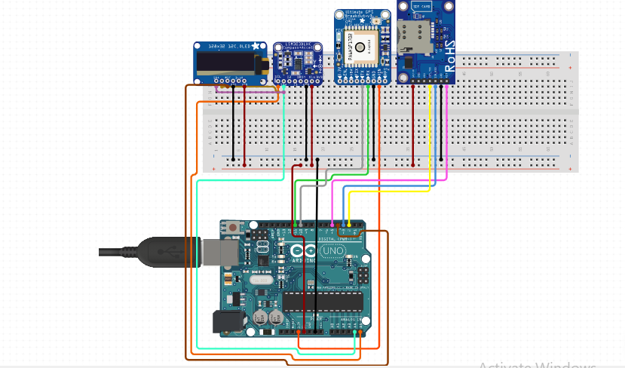

Slide 7
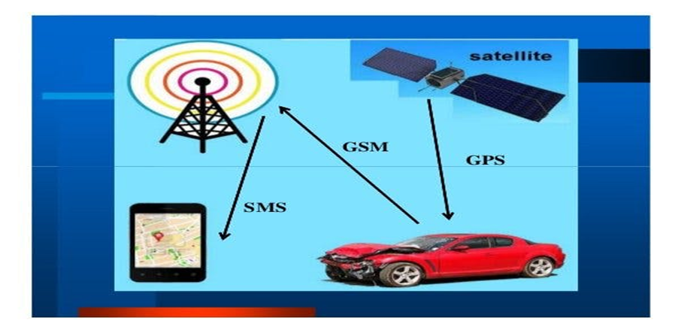

Slide 8
The Team
FOUNDERS:
K HARSHAVARDHAN
M ANOOP
K HARSHINI
G SOWMYA
MANAGEMENT:
K HARSHAVARDHAN(PRODUCT DEVLOPMENT)
M ANOOP(PRODUCT DESIGN)
G SOWMYA(COLLECTION OF DATA AND ANALYSATION)
HARSHINI (STRUCTURE OF PRODUCT AND PLACEMENT)

Slide 9
Market Opportunity
1)Our customers are everyone who own a vehicle and are willing to be safe and buy our product(60millions vehicles)
2)Government to help them with the data gathered and help the with the statistics
1)Our total size of market may be approximately above70 millions of vehicles in the India and increasing it on go…
2)Directly collaboration with companies
3)Government vehicles
1)Our position in the market would be top because we have a large number of increase in automobiles in the country(may be in top20)
2)Unique features of the product will make it top(GPS,DATA ANALYSATION,MONITORISING REAL TIME.)
Source- gov.data.in

Slide 10

Product
Product line up:
Shape: installed in a box of dimensions 15x10x5cm,physically its placed in the front of the car
Actives when accident or any installed functions occur
It consists of the components like Arduino , GPS, LCD,GSM

Slide 11
Product Development roadmap:
1)Developing an device which activates on accident
2)Integrating it with our software code
3)Integrating with our databases
4)Rearranging the data and transferring
5)Gathering the accident statistics and to help traffic authorities

Slide 12
REVENUE MODE:
Product price:
1000rs
Development rice and data analyzation:
Depends on the team
Profit expected:
90% of the manufacturing price
Business Model
PRICING MODEL
Manufacturing price:
1000rupees
Selling price:
5000rupees
SALES & DISTRIBUTION MODEL:
1)With the companies of manufacturing
2)Direct selling through marketing
AVERAGE ACCOUNT SIZE

Slide 13
Competition
Direct competition:
1)ENVOYS
2)H2 SAFETY INDIA
3)PRISMOLINE
4)VERTEX SAFET PRODUCTS
Advantages:
1)Accident statistics
2)Monitoring the data
3)Accident occurs
4)Gathering the data

Slide 14


THANK YOU

